Slide 1
I AM STUDENT OF BANO QABIL
SULTAN DADSHAH CHALLAN NO.(258238)

Slide 2
STRENGTH
PRORAMMING
CRITICAL
PROBLEM SOLVING

Slide 3
1. Night owl 2. time mangment 3. mobile
weaknees

Slide 4
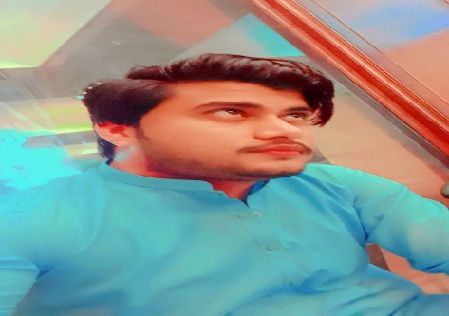
MY FAVORITE PERSONALITY

Slide 5
1. I AM GOOD BOY 2. MY ALL WORK IS COMPLET 3. I LIKE CRICKET
HOBBIES

